Slide 1

DATABASES AND APPLICATIONS
SUBJECT CODE : UQ23CA653A
Samyukta D Kumta
Computer Applications

Slide 2
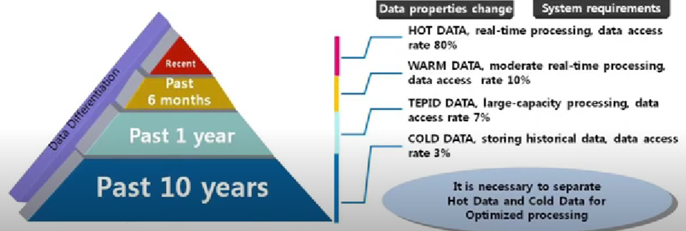
DATABASES AND APPLICATIONS
UNIT-IV- Database Model-Hybrid Database Model
Processing Data Access

Slide 3
DATABASES AND APPLICATIONS
UNIT-IV- Database Model-Hybrid Database Model
Hybrid Database Model
A Hybrid Database is a balanced Database Management System offering high-performance data processing in main memory along with huge storage capacities of the physical disk.
A Hybrid Database offers the characteristics of both an in-memory database and an on-disk database in a single integrated engine. Hence, data can be stored and operated either only in the main memory or in the on-disk, or in the combination of both.

Slide 4
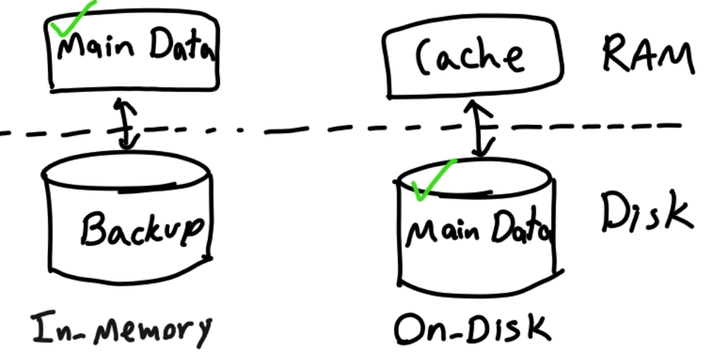
DATABASES AND APPLICATIONS
UNIT-IV- Database Model-In memory and On Disk

Slide 5
DATABASES AND APPLICATIONS
UNIT-IV- Database Model-Hybrid Database Model
In-memory databases(IMDB)
Data is stored primarily in the system's main memory (RAM).
This allows for extremely fast data access and retrieval since accessing data from memory is much quicker than accessing it from disk.
In-memory databases are often used in applications that require high performance and low latency, such as real-time analytics, caching, and high-frequency trading systems.

Slide 6
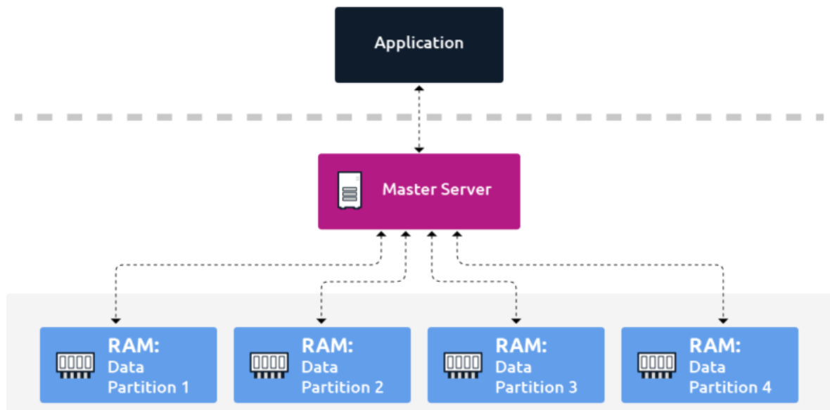
DATABASES AND APPLICATIONS
UNIT-IV- Database Model- In-Memory Database

Slide 7
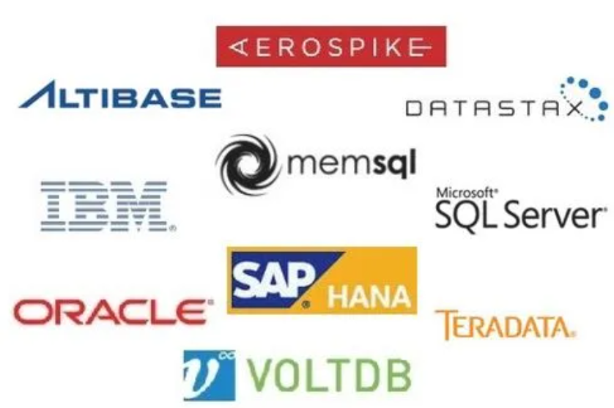
DATABASES AND APPLICATIONS
UNIT-IV- Database Model- Examples of In-Memory Database

Slide 8
DATABASES AND APPLICATIONS
UNIT-IV- Database Model-Hybrid Database Model
On-Disk databases(ODDB)
On-disk databases store data primarily on physical storage devices such as hard disk drives (HDDs) or solid-state drives (SSDs).
Data is retrieved from disk as needed into memory for processing. While accessing data from disk is slower compared to accessing it from memory, on-disk databases can store much larger datasets than in-memory databases, making them suitable for applications that require storing and processing vast amounts of data, such as
Enterprise resource planning (ERP) systems,
Customer relationship management (CRM) systems, and data warehousing.

Slide 9
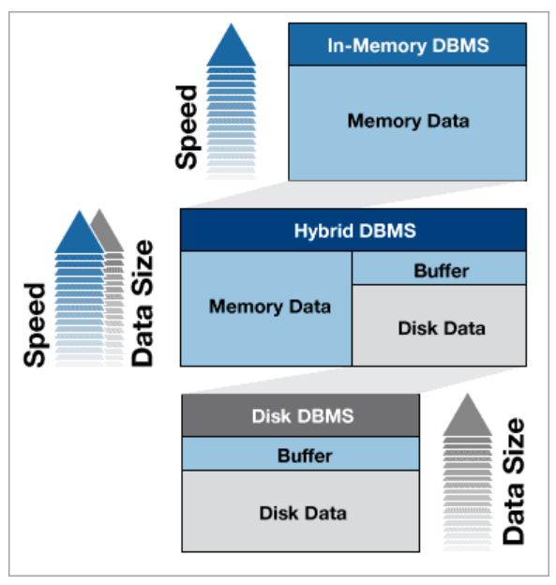
DATABASES AND APPLICATIONS
UNIT-IV-Hybrid Database Model
A Hybrid Database offers considerable advantages over in-memory as well as on-disk DBs.
The Hybrid Database consumes physical disk for storing and retrieving data, but still, it makes use of memory for the data which is in active use to boost the performance.

Slide 10
DATABASES AND APPLICATIONS
UNIT-IV- Database Model-Hybrid Database Model
Examples of In memory and On Disk Databases
SAP HANA
voltDB
Redis
Oracle Database
Apache Ignite
Aerospike
Solid DB

Slide 11
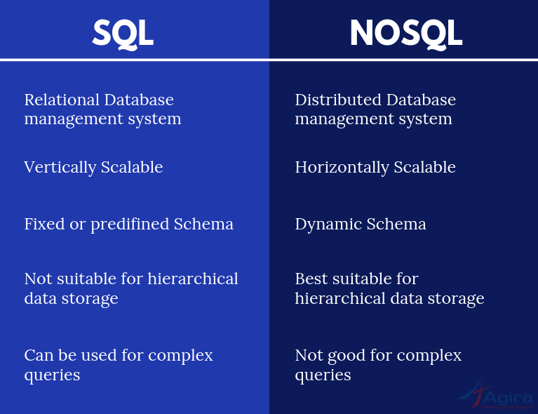
DATABASES AND APPLICATIONS
UNIT-IV- Database Model-Hybrid Database Model
Difference Between SQL, NOSQL and Hybrid Databases

Slide 12
DATABASES AND APPLICATIONS
UNIT-IV- Database Model-Hybrid Database Model
Scalability
It means that when the amount of data is being increased, it requires expansion in the storage capacity and processing power of the existing node.
For instance, the capacity of CPU, the RAM and the stage storage device (SSD) of the DB server. This vertical scalability is very costly because of the underlying hardware cost.
In contrast, the NoSQL databases use horizontal scalability i.e.
when the amount of data gets increased, the system is expanded by adding mode nodes for data storage and computing power,
E.g, adding servers to NoSQL DB infrastructure. This is a cheaper solution when compared to vertical scalability.

Slide 13
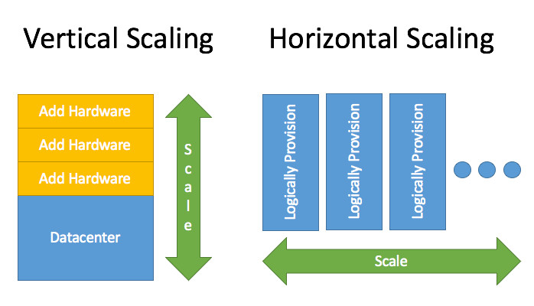
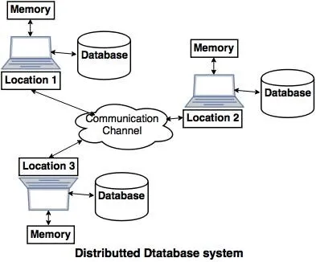
DATABASES AND APPLICATIONS
UNIT-IV- Database Model-Hybrid Database Model

Slide 14
DATABASES AND APPLICATIONS
UNIT-IV- Database Model-Hybrid Database Model
Advantages Of A Hybrid Database Include
Performance:Sorting, storing and retrieving frequently accessed data entirely happens in-memory rather than from disk. This indeed makes the Hybrid Database perform fast.
Cost
Persistence:As the RAM chips can’t get close to the storage density of a physical storage disk, the hard drives are still employed to store the data required for later usage. This assures that the data is not lost in case of power failure.

Slide 15
DATABASES AND APPLICATIONS
UNIT-IV- Database Model-Hybrid Database Model
Advantages Of A Hybrid Database Include
Flexibility:Hybrid databases gives you the capability to execute transactional (OLTP) and analytical (OLAP) workloads parallelly. This is called as HTAP (Hybrid Transactional and Analytical Processing).
Deployment: Hybrid Database allows for both cloud-based deployments and on-premise deployments

Slide 16
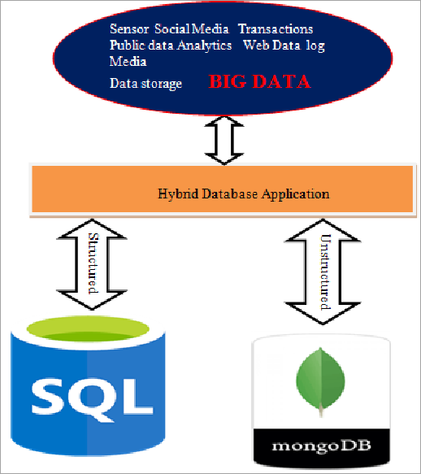
DATABASES AND APPLICATIONS
UNIT-IV- Database Model-Hybrid Database Model

Slide 17
DATABASES AND APPLICATIONS
UNIT-IV- Database Model-Hybrid Database Model
Top Hybrid Databases
Altibase Enterprise Hybrid Database
DataStax Hybrid Cloud Database
Orient DB
LeanXcale

Slide 18
DATABASES AND APPLICATIONS
UNIT-IV- Database Model-Hybrid Database Model
Questions
How Do Hybrid Databases Work?
Case study on The implementation of a hybrid database model in a large-scale enterprise environment to address performance and scalability challenges.
Case study on Hierarchical Database Model

Slide 19

THANK YOU
Samyukta D Kumta
Department of Computer Applications
samyuktad@pes.edu

